Slide 1
A6445 – Major Project Phase - II Domain: VLSI
VARDHAMAN COLLEGE OF ENGINEERING, HYDERABAD
Autonomous institute, affiliated to JNTUH
Team No. - 2020040415
Enhancing Real-Time Clock with a Low-Power Crystal Oscillator and Pulsed Driver
By
20881A04J6 – B Sathwika
21885A0423 – V Aakash Chandra
20881A04J7 – B Laxminarayana
Under the guidance of
Dr. C. Padmini
Associate Professor, Dept. of ECE

Slide 2
Enhancing Real-Time Clocks with a Low-Power Crystal Oscillator and Pulsed Driver
Outline:
Objectives
Motivation
Introduction
Literature Review
Block Diagram
Circuit Diagram
Execution Flow
References

Slide 3
Enhancing Real-Time Clocks with a Low-Power Crystal Oscillator and Pulsed Driver
Objectives:
The main objective of this project are
To enhance the performance of Real-Time Clocks (RTCs) by integrating a low-power crystal oscillator and pulsed drivers.
To replace traditional amplifiers with pulsed drivers, incorporating Delay Locked Loop (DLL) and Switched Capacitor Networks (SCN) for precise pulse generation and programmable time delays.

Slide 4
Enhancing Real-Time Clocks with a Low-Power Crystal Oscillator and Pulsed Driver
Motivation:
The Real Time Clock’s main motive is to timestamp data, schedule events, manage power and for the data accuracy.
As the demand for energy-efficient and accurate timekeeping continues to rise, there is a pressing need to optimize RTC technology.
By integrating a low-power crystal oscillator and innovative pulsed driver technology, this project seeks to address this challenge.
These enhances the RTC accuracy and stability while also conserving energy and improving overall system performance.

Slide 5
Enhancing Real-Time Clocks with a Low-Power Crystal Oscillator and Pulsed Driver
Introduction:
A Real-Time Clock (RTC) is a crucial component in electronics that require accurate timekeeping and timestamping.
RTCs are responsible for tracking the current date and time, even when the device is powered off or in a low-power state.
In generating an RTC, the already implemented Crystal Oscillator which consumes 3.24nW of power over the supply voltage of 1-1.8V with precise crystal values is used.
Amplifiers required for RTC generation can be replaced with pulsed drivers.
Switched Capacitor Networks (SCN) can be used to create programmable time delays by controlling the charging and discharging of capacitors in RTC circuitry.

Slide 6
Enhancing Real-Time Clocks with a Low-Power Crystal Oscillator and Pulsed Driver
Literature Review:
S.No | Authors | Title | Year and Publication | Research Finding
1. | Dongmin Yoon, Taekwang Jang, Dennis Sylvester, David Blaauw | A 5.58 nW Crystal Oscillator Using Pulsed Driver for Real-Time Clocks | 2016, IEEE JOURNAL OF SOLID-STATE CIRCUITS | A Real-Time Clock generation using pulsed drivers and Low power crystal oscillators In Cadence Virtuoso 180nm CMOS Technology.
2. | Mariana Siniscalchi , Fernando Silveira Carlos Galup-Montoro | Ultra-Low-Voltage CMOS Crystal Oscillator | January 28, 2020. IEEE TRANSACTIONS ON CIRCUITS AND SYSTEMS–I: REGULAR PAPERS | 32KHz Crystal is proposed with specific L and C values. Used 2 different approaches for better oscillator consideration. Used Schmitt Trigger for low power consumption and losses
3 | Dongmin Yoon, Taekwang Jang, Dennis Sylvester, David Blaauw | “A 5.58 nW 32.768 kHz DLL-assisted XO for real-time clocks in wireless sensing applications | Feb. 2012, IEEE Int. Solid-State Circuits Conf. Dig. Tech. Papers (ISSCC), pp. 366–368 | DLL and SCN Networks are introduced with different configuration. Different SCN config. Are taken.

Slide 7
Enhancing Real-Time Clocks with a Low-Power Crystal Oscillator and Pulsed Driver
Literature Review:
S.No | Authors | Title | Year and Publication | Research Finding
4. | Zule Xu , Noritoshi Kimura, Kenichi Okada | Ultralow-Power Class-C Complementary Colpitts Crystal Oscillator | July 21, 2020. IEEE SOLID-STATE CIRCUITS LETTERS, VOL. 3 | Proposed Class C Colpitts Crystal Oscillator using CMOS technology for Low Power applications with 24MHz XO 7-μW steady-state power consumption.
5. | Shunta Iguchi, Takayasu Sakurai, Fellow,Makoto Takamiya, | A Low-Power CMOS Crystal Oscillator Using a Stacked-Amplifier Architecture | 2017 IEEE JOURNAL OF SOLID-STATE CIRCUITS | Low power 39.25MHz XO with 4 stages of stacked amplifiers Used 65nm CMOS Technology
6. | Y. Kim, D. Sylvester, and D. Blaauw | Limited contention level converter for robust wide-range voltage conversion | Jun. 2011, IEEE Symp. VLSI Circuits Dig. Tech. Papers, pp. 188–189. | Level Converters are introduced and varied with different voltage levels. CMOS 180nm Technology
7

Slide 8
Enhancing Real-Time Clocks with a Low-Power Crystal Oscillator and Pulsed Driver
Literature Review:
S.No | Authors | Title | Year and Publication | Research Finding
7. | S. Lin, D. Sylvester, and D. Blaauw, | A 150 pW program-and-hold timer for ultra-low-power sensor platforms,” | Feb. 2009, IEEE Int. Solid-State Circuits Conf. Dig. Tech. Papers (ISSCC), pp. 326–327 | Timer and Hold Circuits are introduced. CMOS 180nm Technology
8. | . Lim, I. Lee, D. Sylvester, and D. Blaauw, | Batteryless sub-nW cortexM0+ processor with dynamic leakage-suppression logic | Feb. 2015, IEEE Int. Solid-State Circuits Conf. Dig. Tech. Papers (ISSCC), pp. 146– 147. | Dynamic-leakage suppression logic is introduced in the project. CMOS 180nm Technology
8

Slide 9
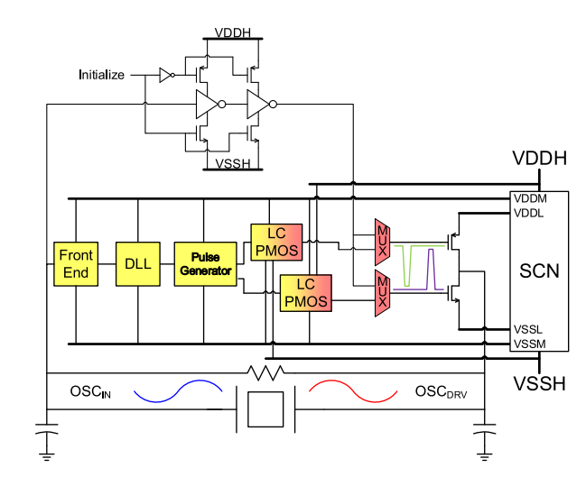
Enhancing Real-Time Clocks with a Low-Power Crystal Oscillator and Pulsed Driver
Block Diagram:
Preamplifier:
Here Preamplifier is kept before the output driver as the small input signal before reaching to output driver must be amplified.
Output Driver
Pre Amplifier
Output Drivers:
By giving the amplified output to the drivers, this results in maximum gate-to-source voltage, minimized ON resistance and giving oscillations with minimum energy loss in the transistor.
NMOS
Crystal Oscillator(3.24nW)
Fig. Block Diagram of Real-Time Clock

Slide 10
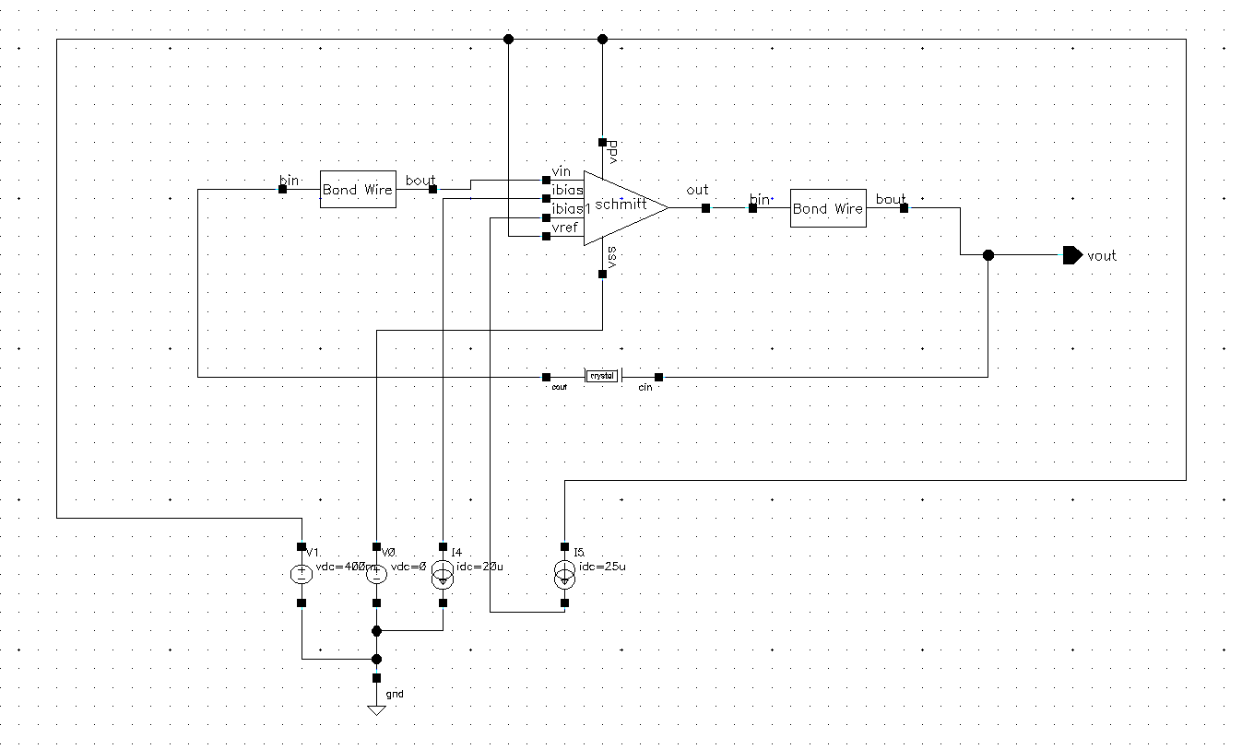
Enhancing Real-Time Clocks with a Low-Power Crystal Oscillator and Pulsed Driver
Block Diagram:
XO Circuit:
Has low power consumption of 3.24nW
Schmitt Trigger is used in place of Op-Amp that minimizes its limitations.
Bond Wire is used that reduces the power.
32KHz Crystal is used with specific L and C values, for WSN applications where low power and low voltage is required.
Fig. Block Diagram of Crystal Oscillator with 3.24nW Power Consumption
10
10
10

Slide 11
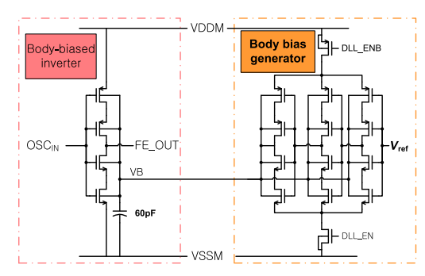
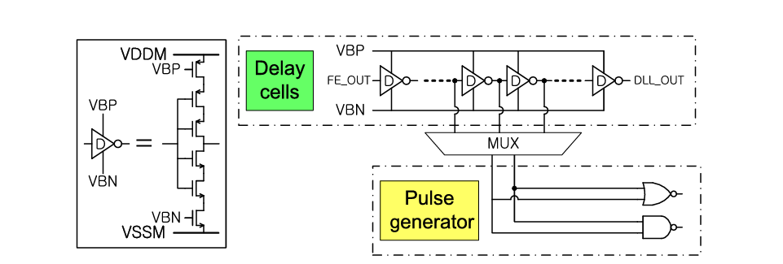
Enhancing Real-Time Clocks with a Low-Power Crystal Oscillator and Pulsed Driver
Circuit Diagram:
FE Block:
Front End block consists of body biased inverter and generator.
It converts sine wave oscillations to the square wave to generate input for next block i.e. DLL.
Body Biased Inverter amplify the sine wave
Body Biased generator dynamically adjusts the body bias, so that trip voltage is set as required.
Fig. Circuit Diagram of Front End Block
DLL Block:
Made with current-starved inverters that minimizes the leakage.
A pair of output from DLL chosen by the MUX for next block i.e. Pulse Generator.
Fig. Circuit Diagram of DLL(Delay Locked Loop)
11

Slide 12
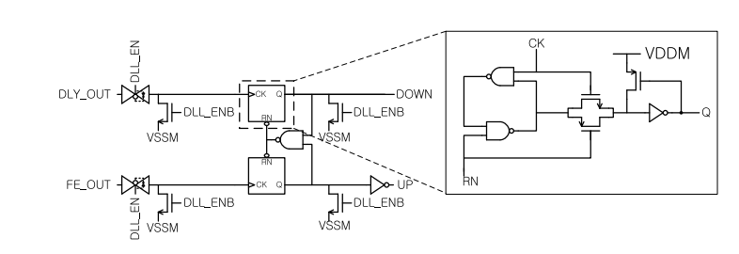
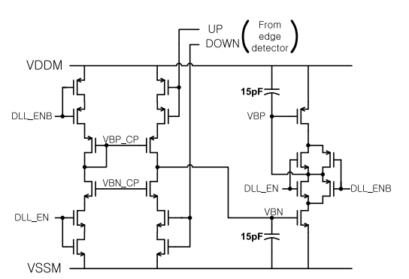
Enhancing Real-Time Clocks with a Low-Power Crystal Oscillator and Pulsed Driver
Circuit Diagram:
Edge Detector and Charge Pump for DLL:
Uses custom cells instead of Flip Flops to reduce number of transistor count.
Only used when it is needed to minimize the overall power consumption (Double stacking is used)
Works periodically
Fig. Edge detector circuit
Fig. Charge Pump Circuit
12
12

Slide 13
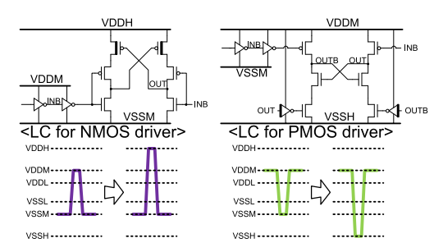
Enhancing Real-Time Clocks with a Low-Power Crystal Oscillator and Pulsed Driver
Circuit Diagram:
Fig. Level Converter Circuit
Level Converter:
The medium-voltage supply for pulse generated from previous block is up-converted to the high-voltage supply level for low ON-resistance.
For NMOS driver, converted to high voltage, the maximum voltage is increased to Vddh.
For PMOS driver, the minimum voltage needs to be decreased to Vssh.
13
13

Slide 14
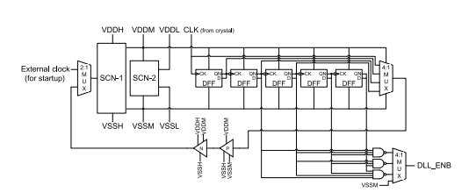
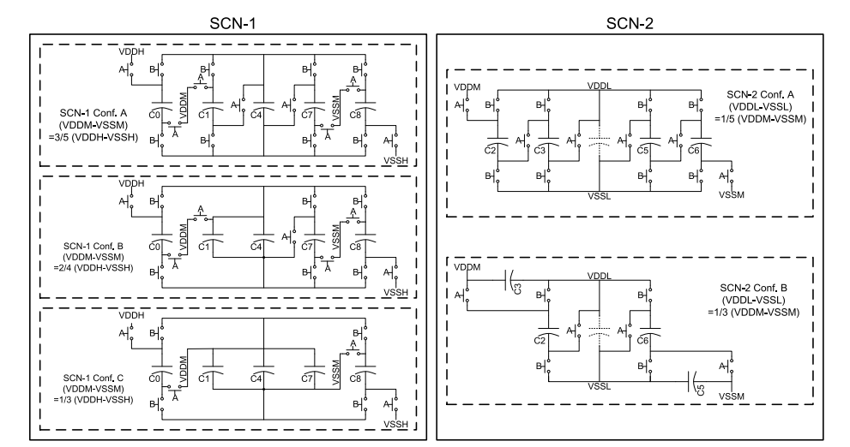
Enhancing Real-Time Clocks with a Low-Power Crystal Oscillator and Pulsed Driver
Circuit Diagram:
SCN:
Parasitic components are considered for high SCN efficiency which minimizes the effect of higher ripple in supply voltage.
SCN-1 generates the medium-voltage supply from high-voltage supply pair.
SCN-2 generates the low-voltage supply from medium-voltage supply pair.
Triple well was used to reduce the power consumption
Uses an external clock for its operation
Fig. Block Diagram of Switched Capacitor Network (SCN)
14
14

Slide 15
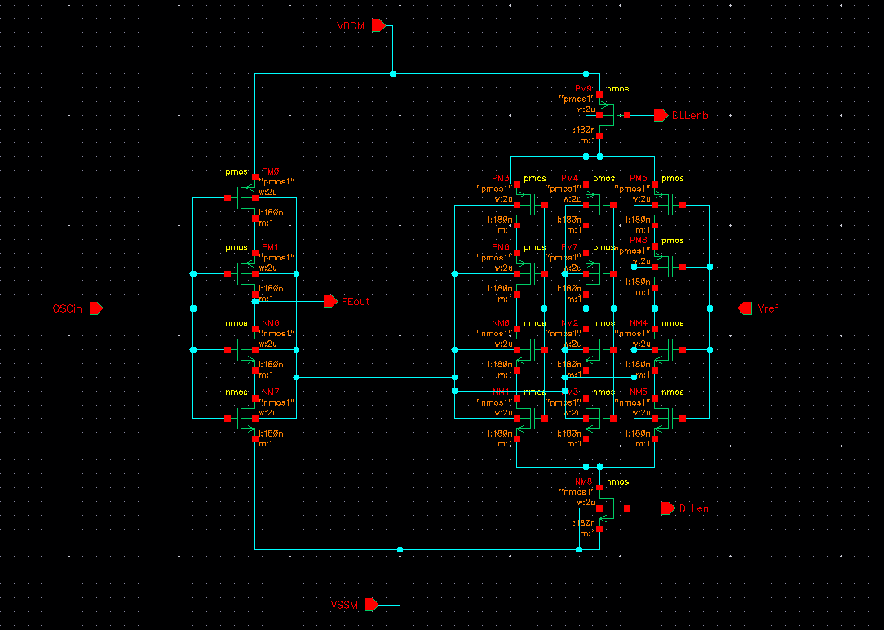
Enhancing Real-Time Clocks with a Low-Power Crystal Oscillator and Pulsed Driver
Circuit Implementation:
Fig. Schematic Diagram of Front End Block in Cadence
15
15
15

Slide 16
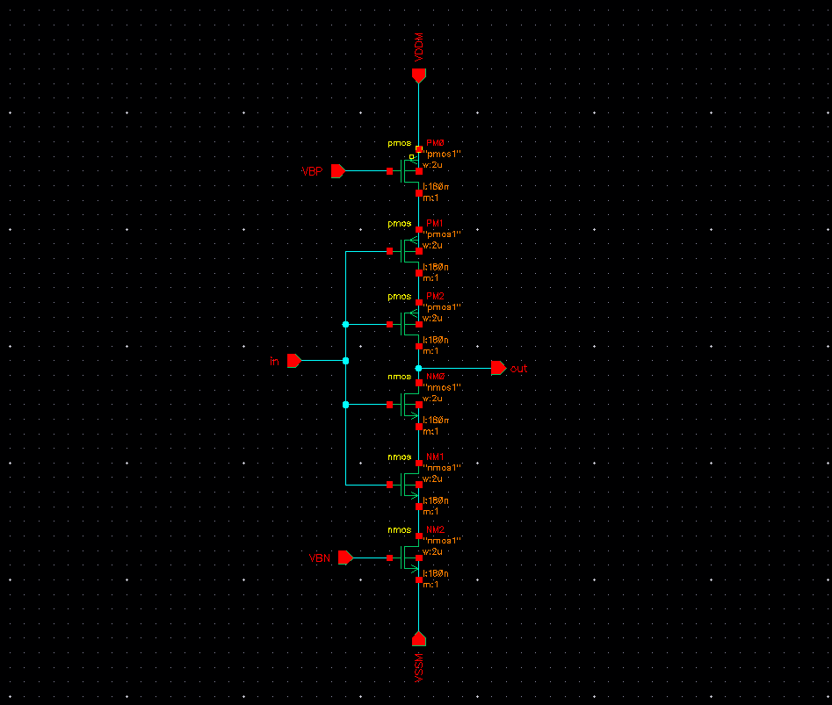
Enhancing Real-Time Clocks with a Low-Power Crystal Oscillator and Pulsed Driver
Circuit Implementation:
Fig. Schematic Diagram of Delay Cells in DLL Block in Cadence
16
16
16
16

Slide 17
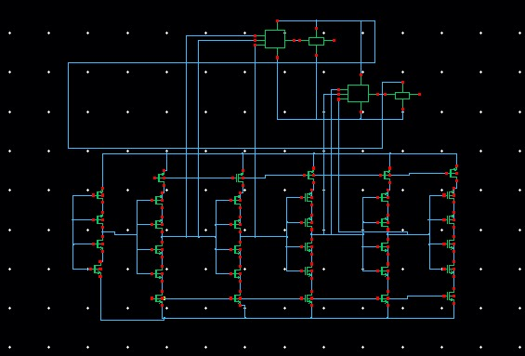
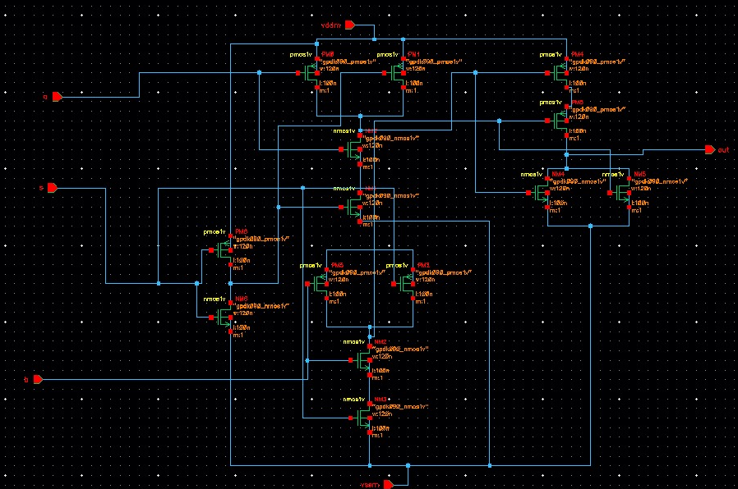
Enhancing Real-Time Clocks with a Low-Power Crystal Oscillator and Pulsed Driver
Circuit Implementation:
Fig. Schematic Diagram of FE, DLL, MUX
Fig. Schematic Diagram of 2x1 MUX
17
17
17
17
17

Slide 18
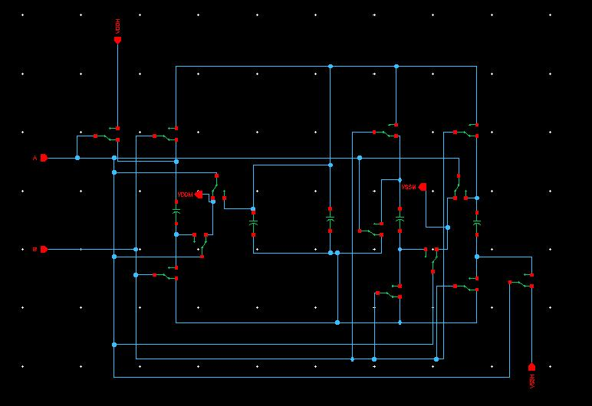
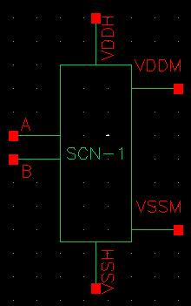
Enhancing Real-Time Clocks with a Low-Power Crystal Oscillator and Pulsed Driver
Circuit Implementation:
Fig. Circuit Diagram of SCN-1 conf. B
18
18
18
18
18
18

Slide 19
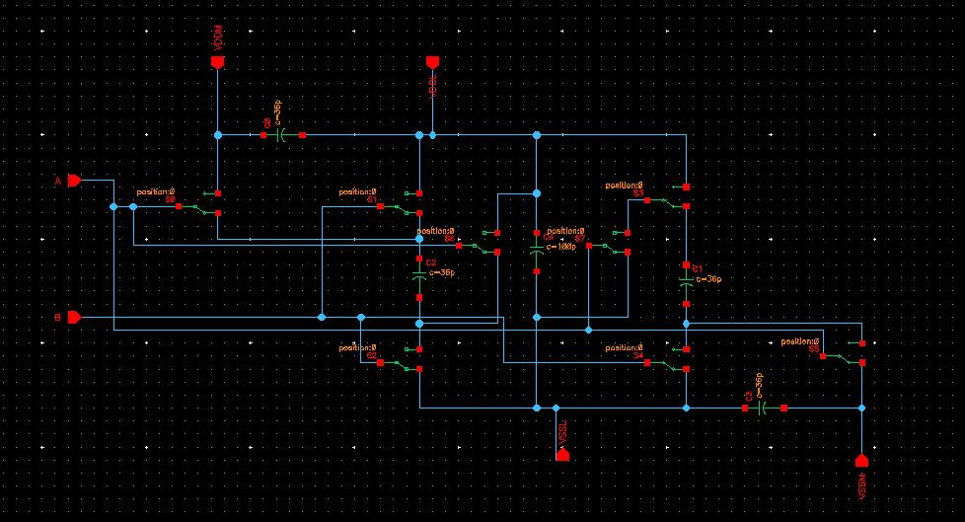
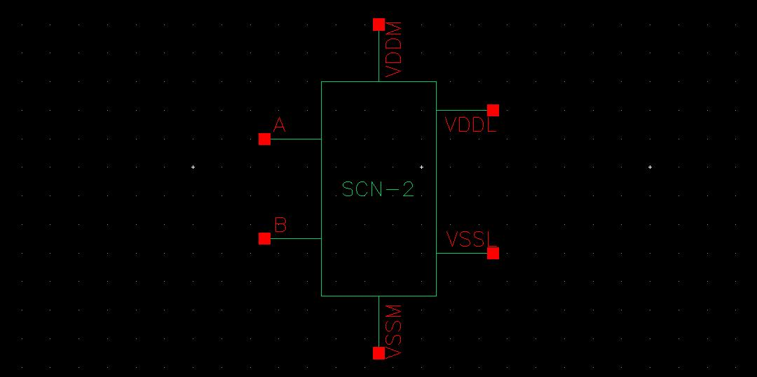
Enhancing Real-Time Clocks with a Low-Power Crystal Oscillator and Pulsed Driver
Circuit Implementation:
Fig. Circuit Diagram of SCN-2 conf. B
19
19
19
19
19
19

Slide 20
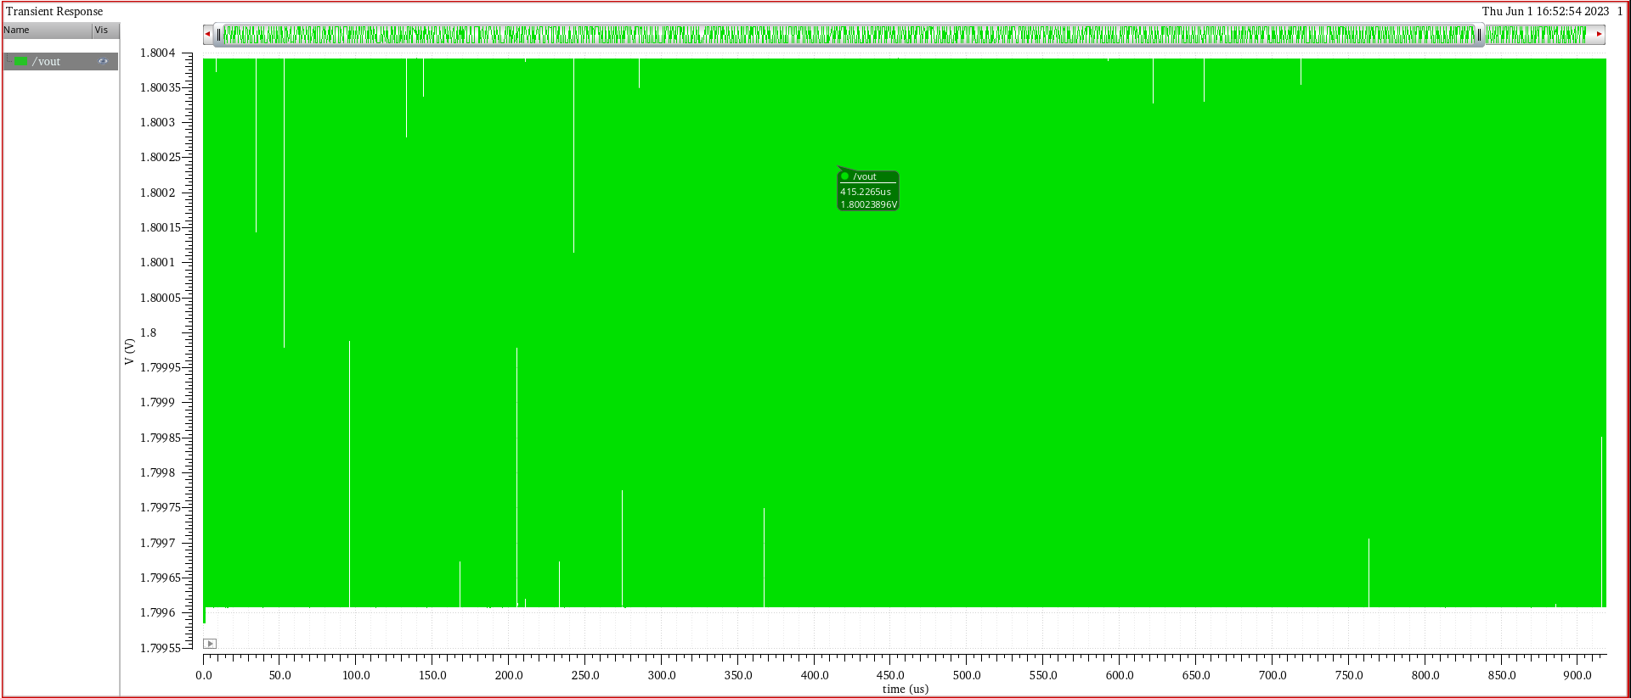
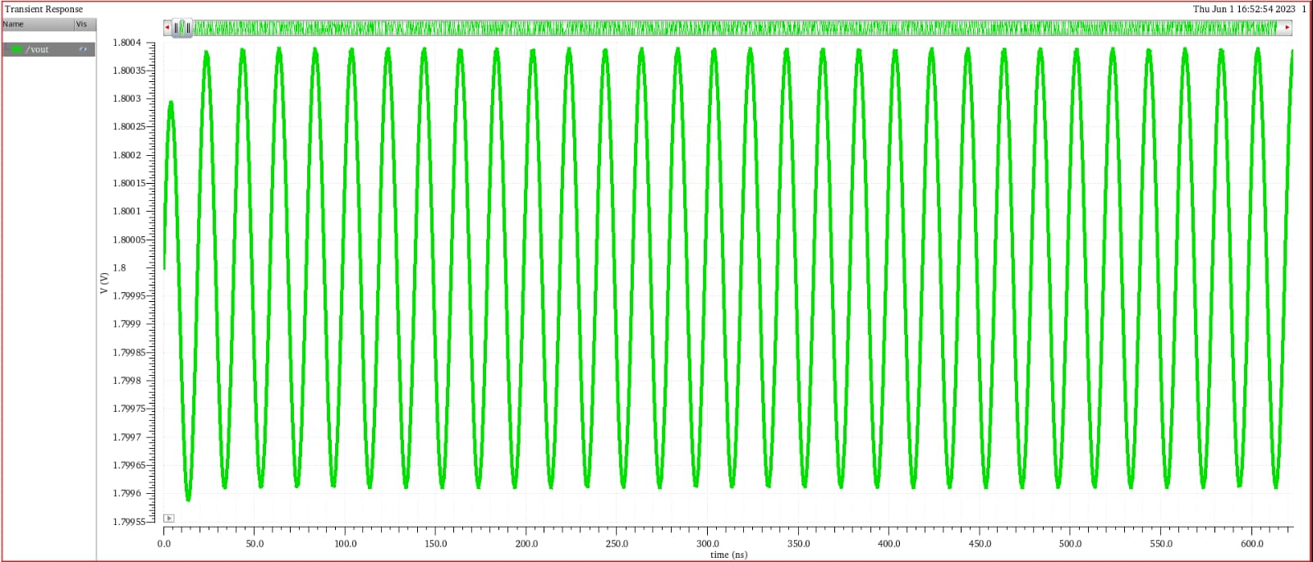
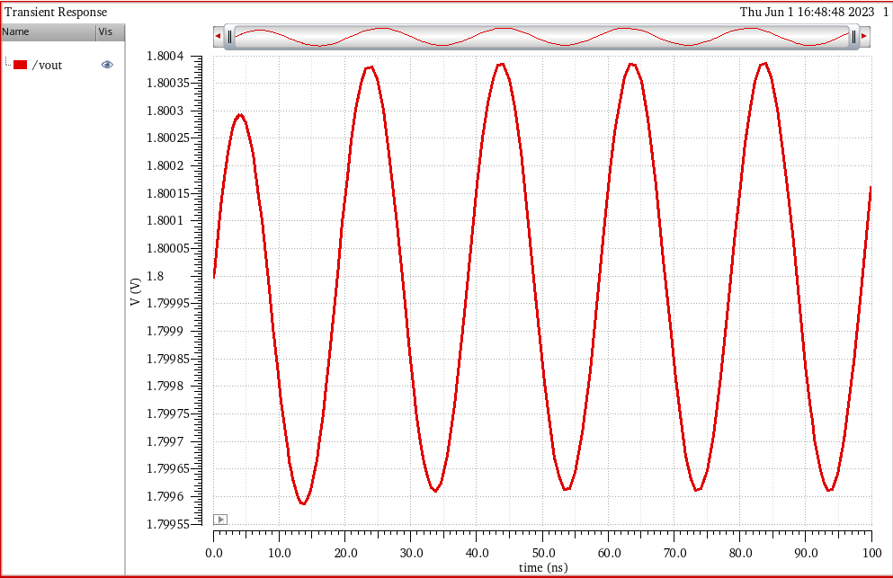
Enhancing Real-Time Clocks with a Low-Power Crystal Oscillator and Pulsed Driver
Previous Crystal Oscillator Output:
20
20
20
20
20
20

Slide 21
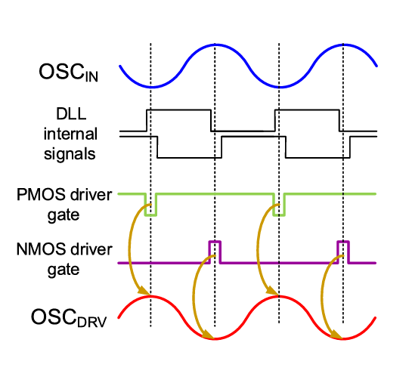
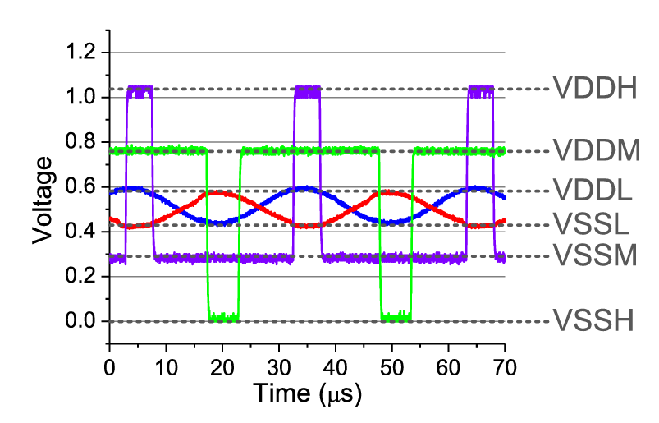
Enhancing Real-Time Clocks with a Low-Power Crystal Oscillator and Pulsed Driver
Expected Output:
Fig. Expected Waveforms of RTC using XO
21
21
21
21
21
21
21

Slide 22
Enhancing Real-Time Clocks with a Low-Power Crystal Oscillator and Pulsed Driver
References:
[1] D. Yoon, T. Jang, D. Sylvester, and D. Blaauw, “A 5.58 nW crystal oscillator using pulsed driver for real-time clocks,” IEEE J. Solid-State Circuits, vol. 51, no. 2, pp. 509–522, Feb. 2016.
[2] Siniscalchi, Mariana, Fernando Silveira, and Carlos Galup-Montoro. "Ultra-low-voltage CMOS crystal oscillators." IEEE Transactions on Circuits and Systems I: Regular Papers 67.6 (2020): 1846-1856. [3] Xu, Zule, et al. "Ultralow-power class-c complementary colpitts crystal oscillator." IEEE Solid-State Circuits Letters 3 (2020): 274-277.[4] Melek, Luiz Alberto Pasini, Márcio Cherem Schneider, and Carlos Galup-Montoro. "Operation of the classical CMOS Schmitt trigger as an ultra-low-voltage amplifier." IEEE Transactions on Circuits and Systems II: Express Briefs 65.9 (2017): 1239-1243.
[5] Iguchi, Shunta, Takayasu Sakurai, and Makoto Takamiya. "A low-power CMOS crystal oscillator using a stacked-amplifier architecture." IEEE Journal of Solid-State Circuits 52.11 (2017): 3006-3017.

Slide 23
Enhancing Real-Time Clocks with a Low-Power Crystal Oscillator and Pulsed Driver
Any Questions/Discussions ???

Slide 24
Enhancing Real-Time Clocks with a Low-Power Crystal Oscillator and Pulsed Driver
Thank You !!!

